Slide 1
Delete these slides before distribution. They are intended only for guidance.
Welcome to the new Azure PowerPoint template
Below are some useful quick links.
Azure Brand Guidelines
Azure Icon Guidance
Azure photography (adding 75 new images this month)
Office and Firstline Worker photography
Contact C+E Brand
Color usage for illustration and chart/graphs
Blue
R0 G120 B212
Hex #0078D4
Primary Rich Black
R0 G0 B0
Hex #000000
Accent Light Blue
R80 G230 B255
Hex #50E6FF
Dark Gray
R60 G60 B65
Hex #3C3C41
Medium Gray
R117 G117 B122
Hex #75757A
Primary White
R255 G255 B255
Hex #FFFFFF
Light Gray
R235 G235 B235
Hex #EBEBEB

Slide 2
Intelligent Cloud Bootcamp – Microsoft Cloud Adoption Framework in der Praxis
Niels Ophey, OCP CSA
23.01.2020
WLAN Event Code: msevent661xn

Slide 3
Informationen
1.Kaffeepause 10:45-11:00 Uhr
Mittag 13:00-13:45 Uhr
2.Kaffeepause 15:00-15:15 Uhr

Slide 4
Agenda
Intro Cloud Adoption Framework
Strategy-Plan-Ready
Governance
Migrate

Slide 5
Microsoft Cloud Adoption Framework for Azure
Adopt
Define strategy
Understand motivations
Business outcomes
Business justification
Prioritize project
Plan
Digital estate
Initial organization alignment
Skills readiness plan
Cloud adoption plan
Ready
Azure readiness guide
First landing zone
Expand the blueprint
Best practice Validation
Migrate
• First workload migration
• Expanded scenarios
• Best practice validation
• Process improvements
Innovate
• Innovation guide
• Expanded scenarios
• Best practice validation
• Process improvements
Govern
Methodology • Benchmark
initial best practice • Governance maturity
Manage
Business commitments
operations baseline • Ops maturity

Slide 6
Pop Quiz
What is the most common reason for adoption blockers?
Business Justification
Organization Readiness
Technical Capability
Which of the following risks lead to adoption blockers?
Interruption to the business
Data or privacy leaks
Unexpected cloud costs
Which of the following help prevent loss of data?
Mature security baseline
Resource consistency
Azure Blueprints & Policy
How do Azure Blueprints and Policy help with data leaks?
They are security tools
They are tools to block attacks or intrusion
They are tools which consistently apply security and operations requirements
Notes:
For each of these questions, assume the Cloud Adoption Team and Cloud Governance Team are in the room for planning discussions.

Slide 7
Pop Quiz
If a customer has a big gap around security baselines, who do you want to engage?
IT or Cyber Security
IT or Cloud Operations
Finance
If a customer has a big gap around cost management, who do you want to engage?
IT or Cyber Security
IT or Cloud Operations
Finance
X
If a customer has a big gap around resource consistency, who do you want to engage?
IT or Cyber Security
IT or Cloud Operations
Finance
Your customer is on O365 & is new to Azure, what’s the fastest way to mature the identity baseline?
AD running on a VM in Azure
AD Sync to new Azure AD Tenant
Existing Azure AD Tenant
Notes:
For each of these questions, assume the Cloud Adoption Team and Cloud Governance Team are in the room for planning discussions.

Slide 8
Pop Quiz
Why did we create a management group per business unit?
Why did we create a management group per region?
Why do we suggest different subs for prod and non-prod environments?

Slide 9
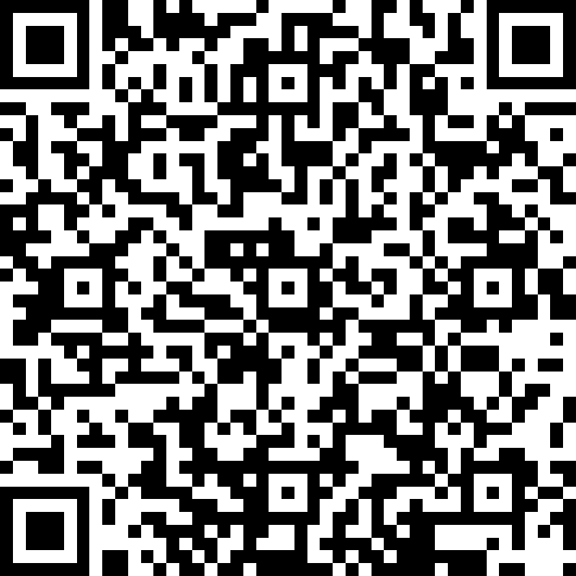
Feedback

Slide 10
Danke aka.ms/ic-bootcamps

